Slide 1
Enhancing Sustainability Data and Reporting: a proof of concept for Australian agriculture.
NATURAL AND SOCIAL CAPITAL ASSESSMENT SCOPE
This project is supported by the Cotton Research and Development Corporation, through funding from the Australian Government’s National Agriculture Traceability Grants Program and the Queensland Department of Agriculture and Fisheries.

Slide 2
BACKGROUND
The Australian cotton industry is working on an ambitious project to significantly enhance its already sound sustainability data collection and reporting to:
Develop a framework with indicators that are aligned to major current and emerging market-based sustainability standards
Identify cost-effective and robust data sources for indicator gaps
Use the enhanced data to explore if the industry can use this single data source for multiple purposes, including:
Create industry-scale natural and social capital assessments (this work is the focus of this paper)
Give customers and other stakeholders better access to the data they need for decision-making and sustainability disclosures
Set Science Based Targets
Produce annual integrated reports to more clearly communicate the links and trade-offs between natural, social, and financial capital
Measure the outcomes of natural and social capital “regenerative” practices.
SCALABILITY
The project is designed to be scalable and repeatable across all industries; it will provide a proof-of-concept for other Australian agricultural sustainability frameworks.
Progress and learnings from the project will be regularly shared with other industries, so we can work towards consistent indicators, credible and robust reporting, and increased awareness and support from our farmers
Decisions and assumptions will be documented to provide consistency for future assessments by cotton and other industries, and to provide defensible justifications of decisions.
STAKEHOLDER FEEDBACK
These slides and supporting documents were shared at natural and social capital working group (coordinated via the Australian Agriculture Sustainability Framework community of practice) meetings held on 6 and 10 November 2023. Key questions and feedback are highlighted in yellow on relevant slides.

Slide 3
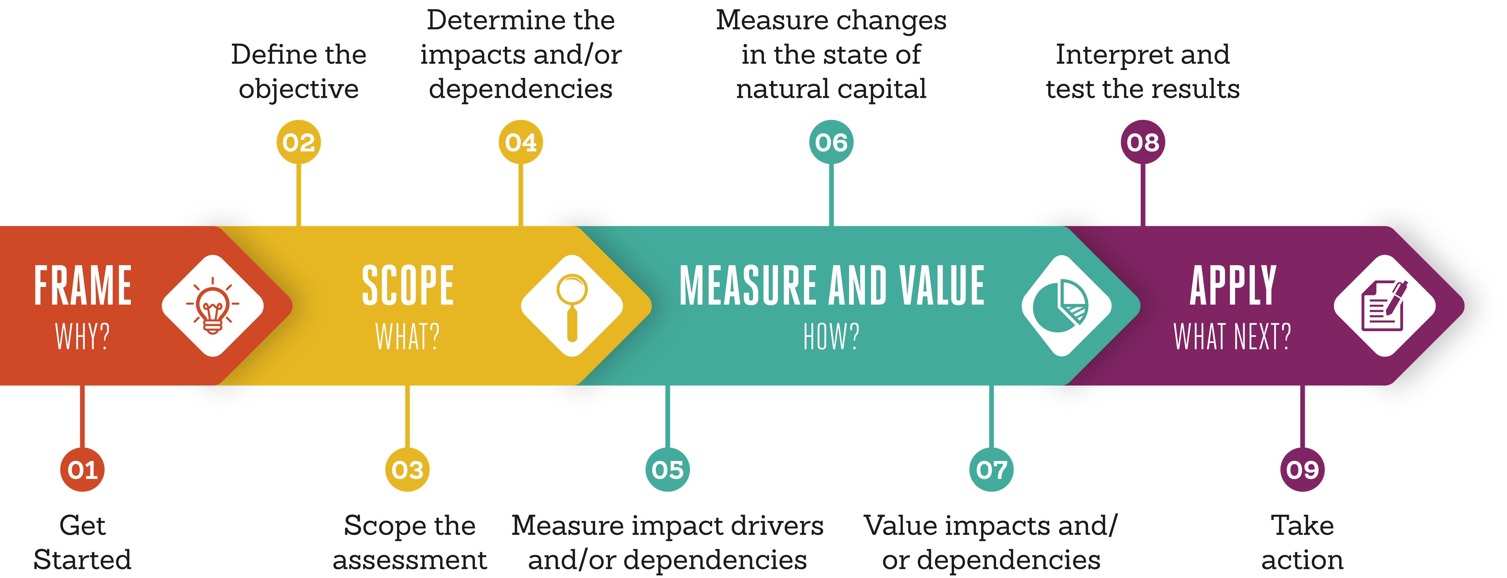
NATURAL & SOCIAL CAPITAL
ASSESSMENT PROCESS
A capital is the stock of an asset that combines to yield a flow of benefits or “services” to people. Businesses rely heavily on natural, human, social, produced and financial capital. For that reason, they are referred to as dependencies. To a greater or lesser extent, all businesses also have an impact on natural, human, and social capital with every action they take. A capitals assessment helps businesses understand, measure and value their relation to nature and society in order to make better informed decisions and create future-proof businesses.
The Australian cotton industry and Queensland Department of Agriculture and Fisheries (QDAF) are working together to attempt to apply recognised methods to create industry scale natural and social capital assessments. This work follows guidance provided by the Capitals Coalition, a multi-stakeholder organisation recognised as leading the global effort to have the value of all capitals included in decision-making.
A project inception meeting was held on 23 June 2023 to:
Achieve a common understanding of key concepts and definitions (FRAME stage)
Agree and document the project scope (SCOPE stage)
Preliminary agreement on priority cotton industry impacts and dependencies to value (MEASURE AND VALUE stage).
A summary of the meeting output is on the following pages.
Also included is additional brief background for each step to provide a summary of key Capitals Coalition terms and concepts which may be new to members of this Activity Group. For more detailed guidance, refer to the Capitals Coalition.

Slide 4
CONTEXT
Australian cotton is grown on up to 1,500 farms in more than 150 regional communities. Cotton is grown mainly on family farms in inland eastern Australia, and starting to be grown in northern Australia in new areas being developed for sustainable cropping. After picking, cotton is sent to a gin where lint is separated from seeds. There are no spinning mills in Australia; all lint is exported.
In the 1990s, the Australian cotton industry gained a reputation for excessive water and pesticide use. Sustained and coordinated investment in the industry since then, including becoming the first Australian agricultural industry to independently assess its environmental impacts in 1991, has seen long trends of improvement in many sustainability areas.
The industry wants to continue its work to build customer and community trust in the industry, and provide cotton growers with evidence to help them assess if they can make changes to improve their sustainability. This natural and social capital assessment is one tool to do this.
The assessment boundary is Australian cotton farms.
INTENDED APPLICATION OF NATURAL AND SOCIAL CAPITAL ASSESSMENT
The purpose of this work is to communicate internally and externally for two reasons:
Provide more insightful data to improve decision-making for growers (giving them the confidence to adopt practices that create both economic and natural value); our wider stakeholders (giving them better contextual information to inform decisions on buying Australian cotton); and the cotton industry itself (enhancing our ability to monitor progress and allocate resources)
Contribute to a scientifically robust alternative to the EU’s Product Environmental Footprint to demonstrate sustainability of Australian food and fibre.

Slide 5
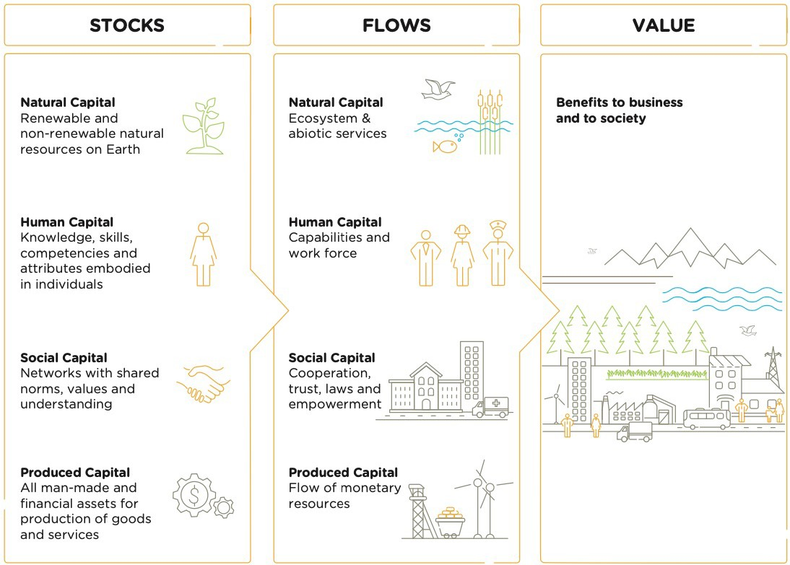
1.1 THE FOUNDATIONAL CONCEPTS OF NATURAL, HUMAN, SOCIAL, AND PRODUCED CAPITALS
A capital is the stock of an asset that combines to yield a flow of benefits or “services” to people. When invested in and managed responsibly, the asset creates value. If we “draw down” on the capital stock itself we limit its ability to provide value to people and the economy, and if we degrade it too much, it can stop providing value all together.
Although many things can be considered as a capital stock¹, there are four that are commonly used: natural, human, social, and produced. Businesses depend on all these capitals. For that reason, they are referred to as dependencies.
To a greater or lesser extent, all businesses also have an impact on natural, human, and social capital with every action they take. This impact can be direct and indirect, positive, and negative. Capitals can also be affected by social and economic changes outside the control of the business.
These are referred to as impacts.
A capitals assessment helps businesses understand, measure and value their relation to nature and society in order to make better informed decisions and create future-proof businesses.
¹ For example, the Integrated Reporting <IR> framework is structured on 6 capitals – Natural, Human, Social, Intellectual, Manufactured and Financial. (So is my young adult sustainability novel.)
“Capital” is another term for the “stock” of resources that combine to yield a “flow” of benefits to people and nature.

Slide 6
ASSESSMENT V ACCOUNTING
Natural capital accounting is measuring and valuing change in stocks (extent and condition of natural capital). The System of Environmental Economic Accounting (SEEA) is the global standard for this.
Natural (and social) capital assessment is measuring and valuing change in impacts and dependencies. The Capitals Coalition methodology is the global standard for this.
The cotton industry will be collecting data for stocks, impacts and dependencies as part of its revamped data framework. So, technically, we could produce a capitals assessment and account. We may still do this. But we are focusing on an “assessment” initially for three reasons:
We aren’t confident the industry-scale data will be accurate enough to provide the level of precision an “account” implies
The language of impacts and dependencies is common in new sustainability initiatives like the Taskforce for Nature-related Financial Disclosures and the European Sustainability Reporting Standards (which also requires double materiality – which is achieved via a capitals assessment process).
An account results in an environmental or social profit and loss and balance sheet statement. We’re not convinced this format would be conducive to catalysing change. Instead, we want to apply behavioural science and good design to create a natural and social capital assessment format that compels people to look at it, to use it, and to be motivated to improve – in the same way gym apps or social media analytics encourage users to see how they’re going and compete with themselves to do better.

Slide 8
TARGET AUDIENCE
Cotton growers and their advisers
Cotton industry, particularly the Sustainability Working Group and researchers
External stakeholders, particularly customers of Australian cotton lint and seed, and governments in Australia and overseas.
Industry benefit of more informed industry decision-making: better allocation of resources where they are most needed
Government benefit of internal capacity-building and applying knowledge gained across other industries.
OBJECTIVE
Quantify natural and human capitals to show how the cotton industry creates, preserves or erodes value over time to improve industry and external stakeholder decision-making to grow social licence and market access.
STAKEHOLDER ENGAGEMENT
Engagement will be via:
Regular and ongoing meetings with senior cotton industry leaders and researchers who will form expert groups to inform measurement of capitals, and QDAF who will lead work to value capitals.
Periodic Australian Agriculture Sustainability Framework working group briefings with other agriculture industry sustainability frameworks, natural and social capital input providers, governments and other interested stakeholders to share knowledge and use this work as a proof of concept for other industries
Australian Cotton Sustainability Reference Group six-monthly meeting updates, and other engagement as needed with customers to ensure outputs are fit-for-purpose
Government forums for cross-jurisdictional engagement and consistency.
Workshop question: How will industry use this to grow social licence and market access?
A: This assessment will help farmers decide if they need to change practices to manage natural and human resources, and industry decide if more or less needs to be invested in managing particular natural and human resources. Implicit in the entire project is data will be used to improve outcomes; to be explicit: better data needs to show the industry is performing better.
Workshop question: How does this relate to farmer decision-making / offset markets etc?
A: The intent is, if this works, for farmers to apply ”investment grade” data to the same indicators and methods we use at industry scale, to inform their individual decision-making.
SPECIFIC BENEFITS EXPECTED
Industry benefit of more informed grower decision-making: increased productivity, resilience, and adoption of more sustainable practices
Industry benefit of more informed stakeholder decision-making: increased trust, reduced risk

Slide 9
BOUNDARY¹
Direct operations: farms that grow cotton in Australia.
TECHNICAL ISSUES²
Baseline: 2020, unless otherwise stated.
Temporal boundary: annual assessment where annual data is available; maximum of 5-yearly measurement for expensive or slow-changing indicators.
VALUE PERSPECTIVE
Primarily an industry perspective to reflect the objective of growing social licence and market access. Value to society will be considered where robust data is available and the value or cost is assessed as being material to the industry.
MATERIALITY: DETERMINE IMPACTS AND/OR DEPENDENCIES³
Impacts and dependencies were assessed against PLANET PEOPLE PADDOCK materiality criteria of stakeholder importance and industry impact. The materiality assessment was reviewed by government and industry stakeholders.
Natural capital: Water availability and use. Soil quality and degradation. Land use change.
Social capital: human capital (diversity and first nations inclusion, keeping farmers and permanent employees in the industry, and health & wellbeing of all people working on cotton farms).
IMPACTS, DEPENDENCIES OR BOTH
Impacts on the cotton industry, and on the industry’s dependencies.
TYPES OF VALUE
Quantitative or qualitative, with monetary (market valuation) wherever possible. Expecting extensive monetary valuations may be unrealistic at this stage of the project’s maturity.
¹ A cotton farm is defined as a broadacre farms that includes cotton as one of its rotation crops.
² Capitals Coalition guidance for technical issues includes scenarios and recommends scenarios be used if the business application is to ‘compare options’. This is not the intended application, so scenarios have not been used.
³ The following topics were assessed as being of lower priority to cotton, but QDAF will monitor as they are likely to be material for other industries: Energy, GHG emissions, pesticide use and pollution; social capital/human rights.
Workshop question: What materiality method was used.
A: AA1000 materiality approach (clear criteria for assessing effect on stakeholders and on the business – includes financial impact – and on sustainability topics).

Slide 10
SPECIFY WHOSE VALUE PERSPECTIVE
A key action in your assessment is deciding whose value perspective to consider. You may focus your assessment on the value to business (i.e., business value) or on the value to society (i.e., societal value). An integrated capitals assessment implies a complete assessment should be undertaken and include both value perspectives, as they are integrally linked. However, there can be benefit in initially considering value
perspectives separately so you can focus on how the results of the assessment can be communicated.
TYPES OF VALUE
The value of impacts and dependencies can be provided in three ways: qualitative, quantitative, and monetary.
Qualitative valuation: Valuation that describes natural, human and social capitals impacts or dependencies and may rank them into categories such as high, medium, or low.
Quantitative valuation: Valuation that uses non-monetary units such as numbers (e.g., in a composite index), area, mass, or volume to assess the magnitude of natural, social, and human capital impacts or dependencies.
Monetary valuation: Valuation that uses money as the common unit to assess the values of natural, social and human capital impacts and/or dependencies.
DECIDE ON ASSESSING IMPACTS AND/OR DEPENDENCIES
Your assessment may cover your impacts, your dependencies, or both. This will in part depend on the business application and your objective. A complete assessment considers both impacts and dependencies to gain a full understanding of your company’s risk and opportunity related to natural, human, and social capitals.
It is important to note that impacts and dependencies are interrelated. They can be considered in the three Components of a complete capitals assessment:
Impacts on your business (as a result of your impacts on natural, human and social capitals).
Your impacts on society (as a result of your impacts on natural, human, and social capitals)
Your business dependencies (benefits that your business receives from natural, human, and social capitals)

Slide 11
MATERIALITY
Whether or not a certain impact or dependency is material, and therefore important to include in your assessment, depends on its ability to alter your decision-making.
This materiality matrix can be used to help identify the most significant impact drivers and dependencies of different business activities, but you will need to complete a more comprehensive materiality assessment relevant to your business.
COTTON INDUSTRY MATERIALITY
An assessment of the materiality of cotton industry dependencies and impact drivers has been done in the Excel document attached to this. This work has identified as being most material:
NATURAL CAPITAL:
Prioritising water availability and use and soil quality and degradation also links to other material impacts or dependencies: fertiliser use/pollution, pesticide use/pollution, GHG emissions (via N), C sequestration (via soil).
Land use change / extent of woody vegetation is included because of its importance to stakeholders, and its links to soil and water: water regulation, pesticide use, C sequestration.
SOCIAL CAPITAL:
The initial focus should be on HUMAN CAPITAL. Previous cotton industry research has been used to refine this to focus on the impact drivers of keeping farmers and permanent employees on farms, and of health and wellbeing.
Consideration could also be given to measuring economic value generated, as a relatively simple way for all agriculture industries to provide evidence of this important driver of trust and acceptance.

Slide 12
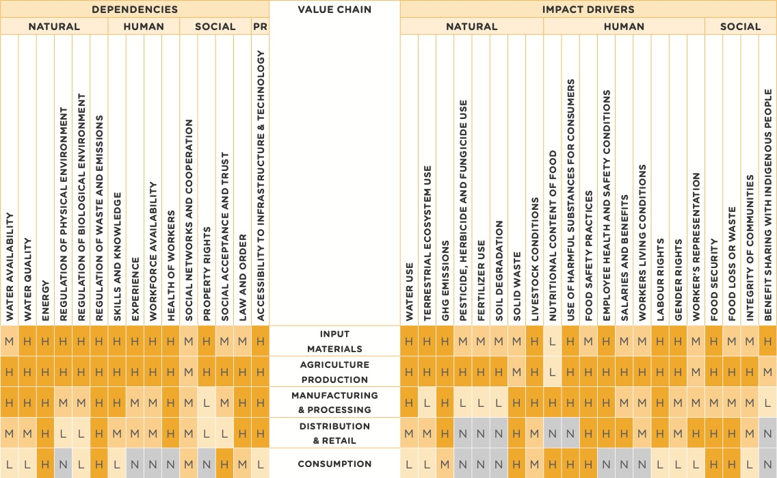
INDICATIVE MATERIALITY MATRIX FOR THE FOOD SECTOR VALUE CHAIN
MATERIALITY ACROSS WHOLE VALUE CHAIN
Based on FOLU (2019), OECD (2016), UNEP (2018), WBCSD
(2018) and SASB (2018)

Slide 13
SOIL QUALITY & DEGRADATION
DEPENDENCIES | IMPACT DRIVERS
Soil quality (FUNCTIONS): Water infiltration Water holding capacity Nutrient cycling Crop production | Soil degradation / improvement (PRACTICES) FOOD Living roots, biodiversity SHELTER Disturbance, cover
CHANGES FROM COTTON ACTIVITIES & IMPACTS | CHANGES FROM EXTERNAL FACTORS (natural or human-induced) | TREND: PRE-EUROPEAN TO BASELINE | TREND: DESIRED
Area of arable land Soil properties TBC by Nat Soil Strat. Maybe: Soil C; Salinity; Acidity; Extractable P | Minimal | Australian soils are degraded and face a number of challenges, including erosion, acidification, salinisation, sodification, soil carbon loss, contamination, and urban and industrial expansion¹. | Soil quality increasing as growers adopt more soil health practice
CONSEQUENCES – COST AND/OR BENEFIT (Consequences assessed as being most significant are bolded) | SIGNIFICANCE | VALUATION TECHNIQUE
Change in yield and input costs (bales/ha, $/ha, ML/ha water, kg/ha nutrients/pesticides) Changes in C storage and GHG emissions (t/ha, t/bale, $/ha) Change in climate resilience Increase or decrease in community trust from perception of soil health practices (% trust) Per SEEA: Change in land value / soil resources ($/ha); change in biomass provisioning ($t or $/ha) Changes in water quality through nutrient/fertiliser discharge (water quality measures) Loss of soil | H H H H (overall, maybe not soil specifically) H M M | TBC by Qld DAF at a later date.
¹ State of the Environment 2021

Slide 14
WATER AVAILABILITY & QUALITY
DEPENDENCIES | IMPACT DRIVERS
Water availability Water allocation Crop production | Freshwater use Volume of water withdrawn and consumed, total and by areas of water stress Water use efficiency Pollution Pesticide and nutrients discharged to water
CHANGES FROM COTTON ACTIVITIES & IMPACTS | CHANGES FROM EXTERNAL FACTORS (natural or human-induced) | TREND: PRE-EUROPEAN TO BASELINE | TREND: DESIRED
Surface water flows / availability Groundwater levels / availability Potential impact on native fish habitat & length of riverbank buffers Potential impact from pesticide and nutrient runoff (mitigated by the closed-cycle nature of most irrigated cotton farms) | Climate change has reduced inflows and water availability, and will create increasingly boom and bust cycles Regulatory changes manage water allocations within sustainable withdrawal limits Upstream impacts on water availability, quality and habitat | Climate change reducing water availability and increasing competition for (and scrutiny on) water use. Inland water quality is generally good in Australia¹. | Continued gains in water use efficiency enable cotton growers to adapt to changing climate conditions that will likely see allocations of sustainably withdrawn water reduced over time.
CONSEQUENCES – COST AND/OR BENEFIT (Consequences assessed as being most significant are bolded) | SIGNIFICANCE | VALUATION TECHNIQUE
Changing water allocations (from climate or regulation) affect crop viability and yield Changes in community and customer trust from perceived impact on water quantity and quality A need to adapt to increased variability / boom and bust cycles | H H H | TBC by Qld DAF at a later date.
¹ State of the Environment 2021

Slide 15
LAND USE (NATIVE VEGETATION)
DEPENDENCIES | IMPACT DRIVERS
Habitat – beneficial and threatened species Carbon sequestration | Land use Woody vegetation conversion or restoration Significant riparian patches conversion or restoration Species biomass / abundance / extinction threat Invasive alien species
CHANGES FROM COTTON ACTIVITIES & IMPACTS | CHANGES FROM EXTERNAL FACTORS (natural or human-induced) | TREND: PRE-EUROPEAN TO BASELINE | TREND: DESIRED
Area of woody vegetation on farms Connectivity of significant riparian patches to regional high priority ecosystems | Climate change/drought: kills planted and existing remnant vegetation; reduces income to invest in restoration Lack of cooperation and/or coordinated support with other industries / agencies hampers grower desire for restoration Biosecurity incursions kill vegetation | Overall, 13.2% of Australia’s native vegetation has been replaced by urban, production and extractive uses of the land. Dryland and irrigated cropping and horticulture occurs on 4.9% of Australia’s land¹. Extent of native vegetation on cotton farms appears to have been largely static for several years. | Extent and condition of native vegetation in traditional cotton growing areas is maintained or enhanced.
CONSEQUENCES – COST AND/OR BENEFIT (Consequences assessed as being most significant are bolded) | SIGNIFICANCE | VALUATION TECHNIQUE
Change in pesticide use from change in beneficials habitat ($/ha) Changes in C stored on farms (t/ha, $/ha) Change in community trust from changes in habitat for threatened species (% trust) Changes in market access relating to changes in vegetation extent (description / value of markets) | H H H H | TBC by Qld DAF at a later date.
¹ State of the Environment 2021

Slide 16
HUMAN CAPITAL
DEPENDENCIES | IMPACT DRIVERS
”Core” skilled employees: Skills and knowledge Experience Motivations to innovate Health and wellbeing Diversity and Indigenous inclusion | Training, including professional development, on-farm skills training, extension activities Income and/or wages; stress, burnout; management style (people-focused, not task-focused Culture that encourages innovation; necessity; Multiple factors drive health and wellbeing – this is the subject of ongoing research Degree a workplace or industry is welcoming and inclusive
CHANGES FROM COTTON ACTIVITIES & IMPACTS | CHANGES FROM EXTERNAL FACTORS (natural or human-induced) | TREND: DESIRED
Skills and knowledge: On-farm skills development, precision agtech Experience: Drivers of keeping core people: water reliability; investment in automation and tech; management style; community connectivity; culture Motivations to innovate: Change in adoption of new practices that support sustainable intensification Health & wellbeing: Investment in training changes risk and/or rate of injuries/fatalities Diversity and Indigenous inclusion (including ‘older’); pathway to career progression | Experience: Migration to cities reduces skilled labour in some regions Health & wellbeing: Climate variability may increase stress, days working in extreme weather etc = increased stress and higher turnover | The combination of technological, climate and social changes make future farming workforce trends difficult to predict. The cotton industry has a culture and reputation that encourage a diversity of people to join the industry, develop their skills, innovate, and increase their satisfaction with the industry.
CONSEQUENCES – COST AND/OR BENEFIT | SIGNIFICANCE | VALUATION TECHNIQUE
Change Skills and knowledge: Productivity & profitability (t/ha, $/ha); change in gap between ‘top 25’ and ‘bottom 25’ farmers and impact on industry risk ($ value of industry reputation) Experience: Change in retention rate ($); change in local skills and collaboration (?) Cost of replacing core employees Impact on farm business culture Loss of corporate knowledge / farm history Impact on productivity Motivations to innovate: Change in adoption of new practices that support sustainable intensification Health & wellbeing: Change in serious injuries and fatalities ($, pressure on rural health services); food/energy poverty (people are more likely to be engaged in a community if feeling good about themselves) Diversity and inclusion | M H M H H | TBC by Qld DAF at a later date.

Slide 17
PRE-READING
While completing this Step keep in mind that
Valuing natural, human, and social capitals can be helpful but is not the only basis for decision making, hence results should be presented as part of a suite of information, including details of the wider socioeconomic, legal, and business context.
There will always be estimation or uncertainty of some kind involved in your valuation. It is important to identify where this occurs and clearly document the limitations of your assessment. Even rough approximations of value, when combined with a good understanding of the context, can provide relevant information for decision making.
TYPES OF VALUATION TECHNIQUES
For each cost and/or benefit identified, you will need to select an appropriate valuation technique based on whether you intend to assess values in qualitative, quantitative, or monetary terms.
Qualitative valuation techniques are used to inform the potential scale of costs and/ or benefits expressed through qualitative, non-numerical terms (e.g., increase in air emissions, decrease in social benefits of recreation).
Quantitative valuation techniques, in turn, focus on numerical data which are used as indicators for these costs and/or benefits (e.g., changes in tons of pollutants, decrease in number of people benefitting from recreation).
Monetary valuation techniques translate quantitative estimates of costs and/or benefits into a single common currency.
All valuation methods have advantages and disadvantages and, generally speaking, a sequential, pragmatic approach from identifying and estimating costs and/or benefits qualitatively, followed by quantification and monetization, when possible, is recommended.
FOR THIS PROJECT, WHERE POSSIBLE WE WILL BE SEEKING TO APPLY MONETARY VALUATION TECHNIQUES.
Value measures and assumptions. The three simplest methods appear to be:
Market and financial price (cost/price of services, opportunity cost etc) aka Exchange Values
Production function (change in output volume or quality)
Replacement costs (cost of replacing capitals with bought capitals, eg fertiliser)

Slide 18
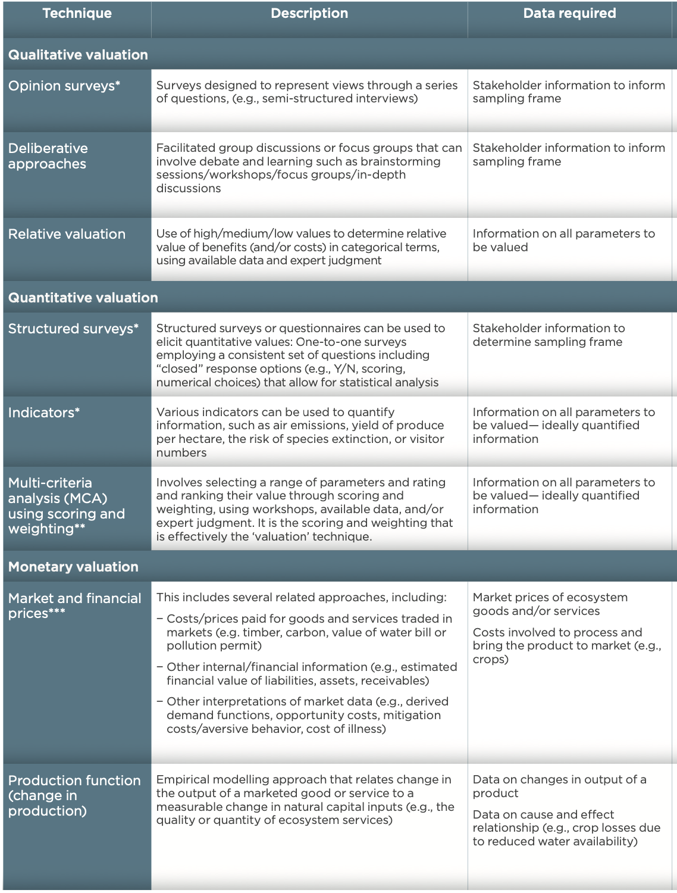
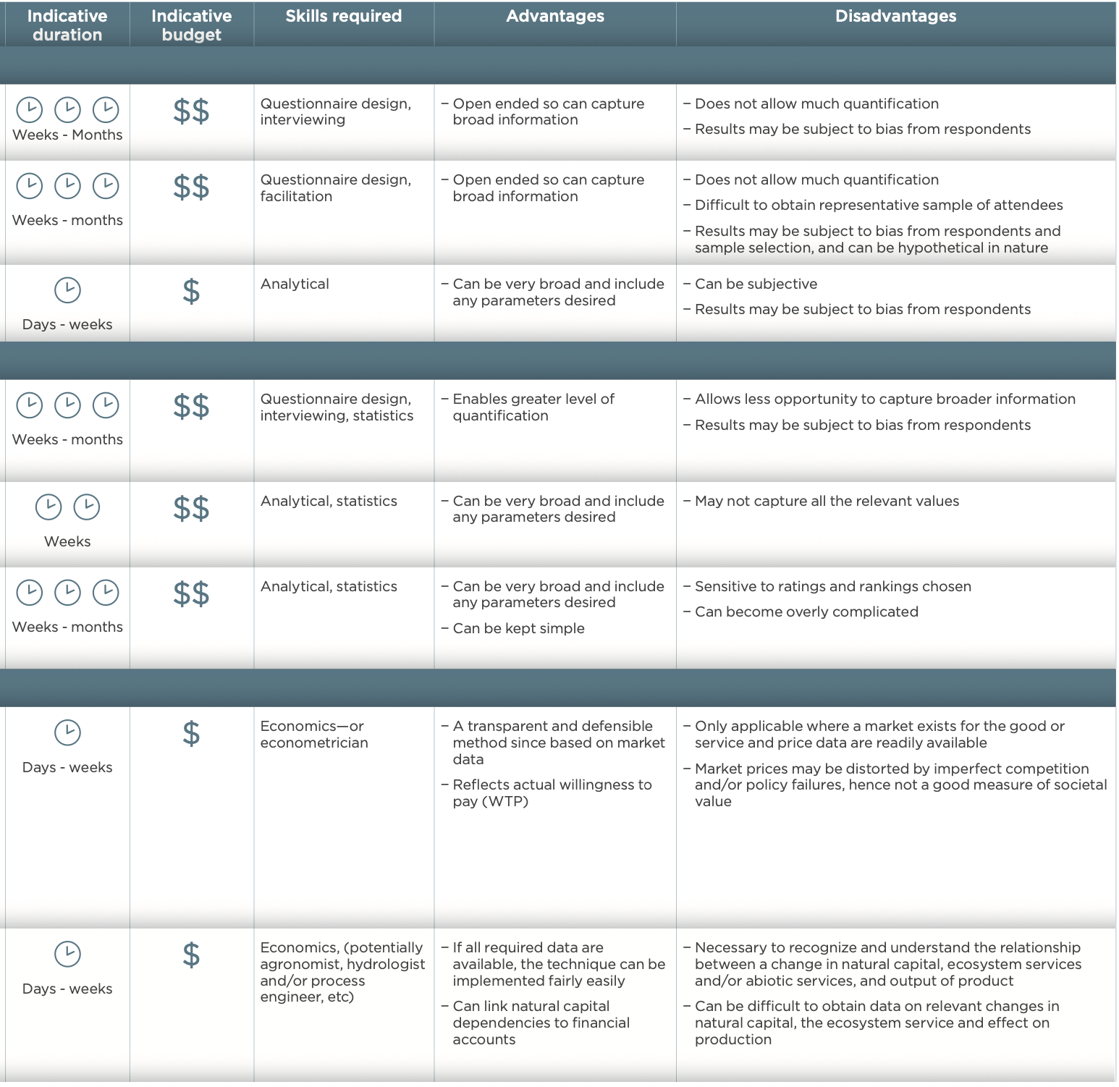

Slide 19
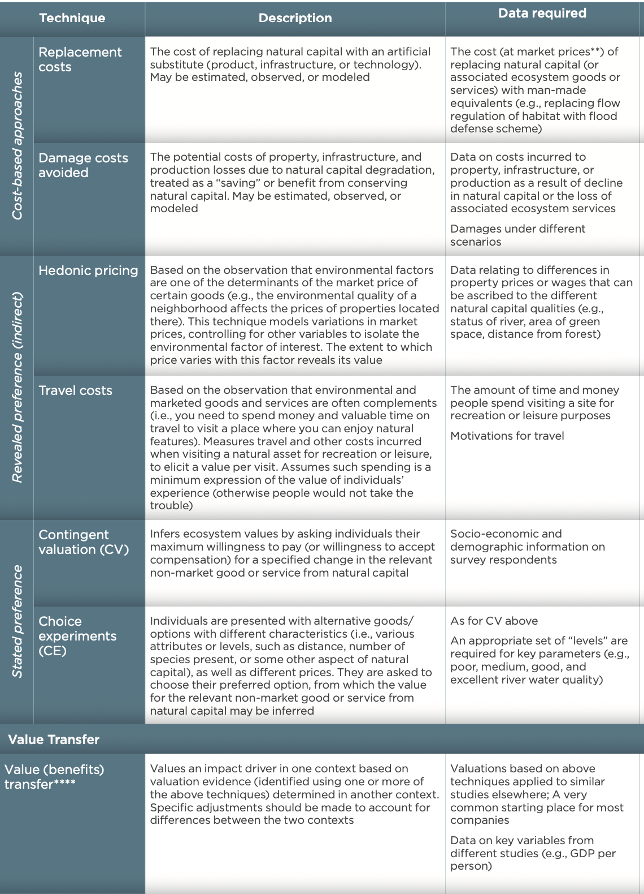
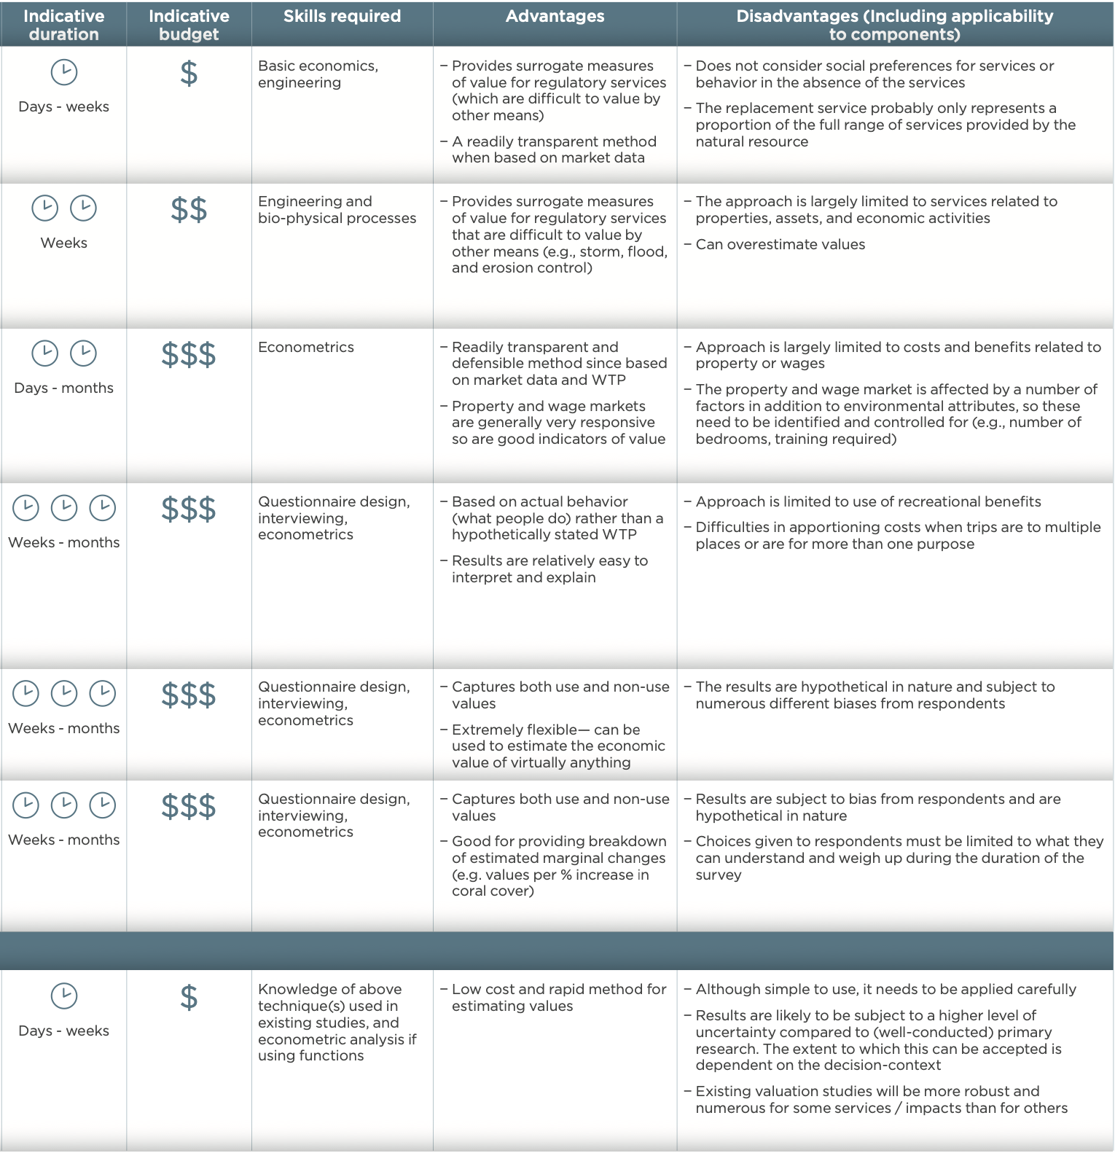

Slide 20
This project is supported by the Cotton Research and Development Corporation, through funding from the Australian Government’s National Agriculture Traceability Grants Program and the Queensland Department of Agriculture and Fisheries.

