Slide 1
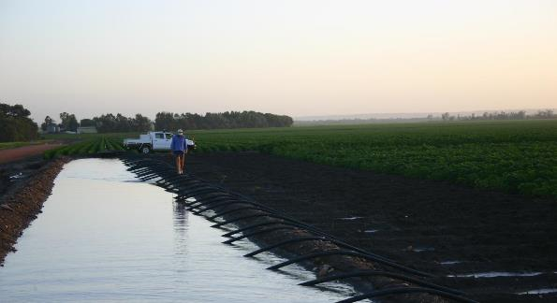
Siphon Irrigation Training
Location Date
Notes:
Ascertain prior knowledge through questioning to help pitch the presentation
What’s siphon irrigation?
How do you do it?
Where have you seen it done?

Slide 2
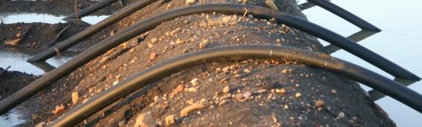
Course Overview
Work health safety and Induction
Irrigation (history, aim, why irrigate, parts of an irrigation system, practical, timing, efficiency)
Hydraulics (overview, practical)
Communication
Getting Around
Practical
Troubleshooting and wrap up

Slide 3
Course timing
9:00-9:20 Work health safety and Induction
9:20-9:50 Irrigation (history, aim, purpose, parts
9:50 - 10:30 Demo and practical – Starting a siphon
10:30 – 10:45 Morning tea
10:45-11:00 Hydraulics
11:00-11:40 Demo/practical: starting, stopping & monitoring
11:40 – 12:00 Communication and getting around
12:00-1:15 Lunch
1:15- 2:00 Practical
2:00 – 2:15 Troubleshooting
2:15-2:30 Wrap up

Slide 4

What does it look like?
Copy link into your browser if the above does not work: https://www.youtube.com/watch?v=n4zRhi3Aykw&feature=player_embedded

Slide 5
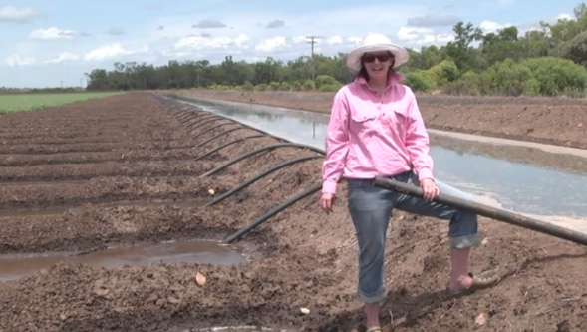
Demonstration video
Copy link into your browser if the above does not work: www.youtube.com/watch?v=cMVFCeoysXc&list=PLQy8KAPn-Dyou6uDnQi9Ba_7utu2ieo47

Slide 6

Part 1: Work health safety (WHS) and inductions

Slide 7
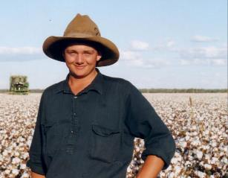
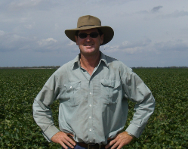
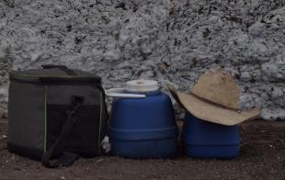
Working Outside
Water
Sunscreen
Wide brimmed hat
Long sleeves
Collar
Long pants
Cotton
Notes:
Irrigation requires long hours in hot weather. There are a number of things you need to do to protect your health and safety in the sun:
Drink water at regular times during the day to replace fluids lost when you sweat (recommended 2-3 litres / day minimum). In hot conditions the trick is to drink before feeling thirsty!
To assist with the evaporation of sweat, wear loose clothing
For maximum sun protection wear a wide brim ventilated hat, SPF rated cotton long sleeve shirts with collars and long trousers
Apply sunscreen regularly to protect any exposed skin. The Australian sun is much harsher than the sun in Europe.
Take all necessary precautions as the effects of heat stress can lead to heat exhaustion and heat stroke – possibly a life threatening condition. The early symptoms of heat stress include muscle cramps, headaches, dizziness, fatigue, loss of coordination, nausea and a week rapid pulse.
If you feel you are experiencing these symptoms from heat stress, advise your supervisor or first aid officer immediately, move to a cool shaded area

Slide 8
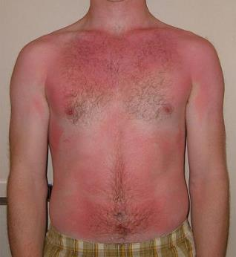
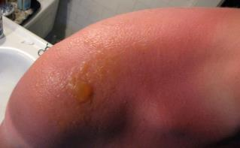
Heat stress
Symptoms include:
Muscle cramps
Headaches
Dizziness
Fatigue
Loss of
coordination
Nausea
Weak, rapid pulse
Heat exhaustion
Heat stroke
Notes:
The Australian sun is much harsher than the sun in Europe.
Take all necessary precautions as the effects of heat stress can lead to heat exhaustion and heat stroke – possibly a life threatening condition. The early symptoms of heat stress include muscle cramps, headaches, dizziness, fatigue, loss of coordination, nausea and a weak rapid pulse.
If you feel you are experiencing these symptoms from heat stress, advise your supervisor immediately, move to a cool shaded area

Slide 9
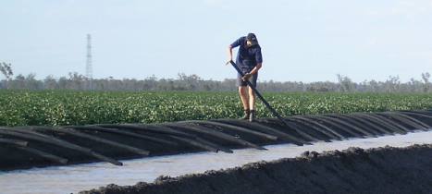
Correct siphon handling technique
Way to minimise injury:
Instead of bending over lift with your foot
Plan how you will lift any heavy loads
Wear protective gloves when siphons are hot
Notes:
Bad posture, repetitive manual handling and heavy lifting can lead to soft tissue injuries. Symptoms of soft tissue injuries include pain, numbness, weakness, burning, tingling or loss of motion.
Starting and stopping siphons is repetitive but there are some techniques you can use to minimise strain such as standing up straight and flicking the siphon with your foot. (are there others)
Before lifting anything heavy:
Think and plan any lifting you perform
Make sure you have a firm footing and your feed are spaced widely apart
Bend your knees
Check the load
Make sure you have a secure grip on the object
Tighten you muscles
Keep your back straight
Lift the load securely and slowly
Keep the load close to your body
Wear protective gloves if you are required to move irrigation pipes and siphons that are hot.
There is a correct technique when moving siphons from one field to another Note to Trainer: There will be a particular process that varies from farm to farm. Usually this will involve using a siphon trailer. In most cases siphons used in a particular field will stay in that field all season and will only be collected once the last irrigation has been applied and the area has dried out before picking.
If you’ve done everything correctly and still feel like you might have a soft tissue injury it is your responsibility to report that to your supervisor so they can help you.

Slide 10
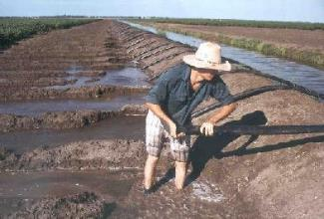
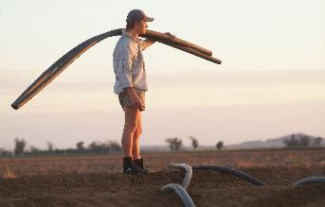
Precautions working in water
Wear suitable enclosed footwear
Walk on the walkways rather than in the channels
Notes:
You should wear suitable footwear, that does not cause blisters and ensures that your feet are protected from sharp stubble and other foreign material
Walk on the walkways rather than in the channels.

Slide 11
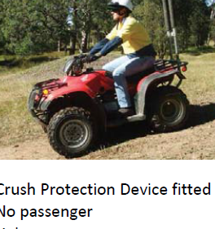
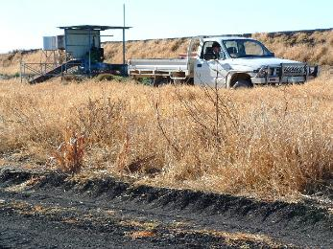
Things to tell your manager
If you can or can’t swim
Your qualifications and
experience driving different vehicles
Notes:
Informing your manager if you can swim
Accidents have happened in the past. If your employer doesn’t ask, you must tell your manager if you can’t swim or are not a confident swimmer at every place you work.
Experience driving various vehicles to irrigation sites
There are many different types of vehicles available on the farm. In Australia you must have a license to drive different types of vehicles. If your employer doesn’t ask you must tell your manager if you have the qualifications and experience to drive each of the vehicles such as utes (automatic or manual), quad bikes, two-wheeler motor bikes or any other vehicle.

Slide 12
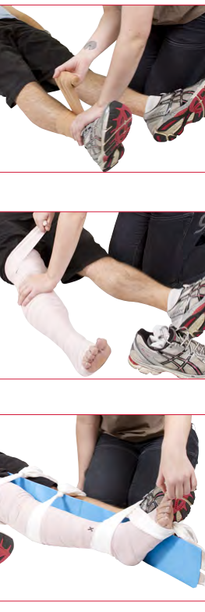
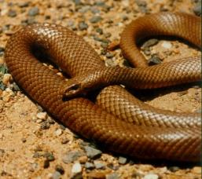
Hazards
Snakes are sometimes found in water channels, as well as in the cotton field
What to do if you encounter a snake
Source: St John (NSW): http://stjohn.org.au/assets/uploads/fact%20sheets/english/FS_snakebite.pdf
Notes:
Snakes are found in cotton fields. They may also be found in irrigation pipes and siphons, around water channels, as well as in the cotton field. Many snakes are poisonous. If you come across a snake move quickly away and let it move away. If other workers are in the vicinity, let them know where the snake has moved.
If bitten by a snake, place a firm pad over the bite, bandage securely and keep the limb as still as possible. Stay as still and calm as possible. Use the communication system to get help quickly.

Slide 13
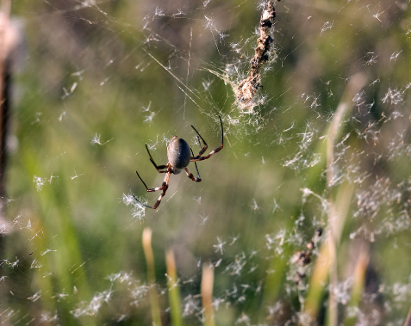
Hazards
Spiders
What to do if bitten
Symptoms
Notes:
Not all spiders in Australia are deadly. Red-back spiders are relatively common and under some circumstances can be deadly. If bitten inform your supervisor. Apply cold pack/compress to area to lessen pain and seek medical aid.
If you are bitten by a spider and experience swelling, discomfort, pain, sweating, muscle spasms, dizziness or any unusual feelings inform your supervisor.

Slide 14
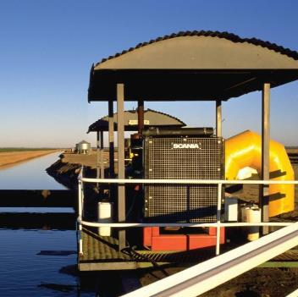
Basic safety around pumps
  Keep away from moving
  parts i.e. belts
  Be aware of loose clothing, long
  hair or anything else that could drag you into a moving part.
  Check for snakes
  Turn off the engine before
  refuelling
  Don’t smoke around fuel
  Follow the safety warnings around electrical equipment.

Slide 15
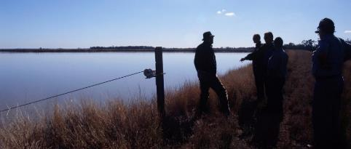
On farm induction
This is not a farm induction
Your employer will give you an induction.
The induction will comprehensively cover safety and…
  Reporting
  Clothing
  Transport
  Emergencies
  Machinery operation
  And a range of
  other topics
Notes:
On farm induction (what to expect)
Today’s training is not an on farm induction. Your employer must give you an induction when you first start working on the farm. This should include who to report to, hazards on the farm, communication on the farm, work clothes, hygiene, protective clothing and equipment, adequate food and water, fatigue, Riding a motorbike/ ATV, handling chemicals on the farm, machinery operation and maintenance, irrigating, snakes, being ready for emergencies, injury reporting, workplace health and safety legalities. This would be a good time to inform your employer about your swimming and driving ability.

Slide 16
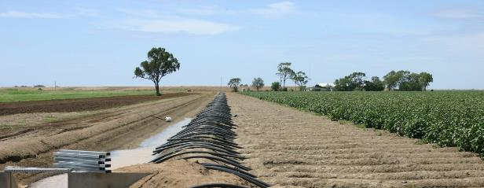
Part 2: Introduction to Irrigation

Slide 17
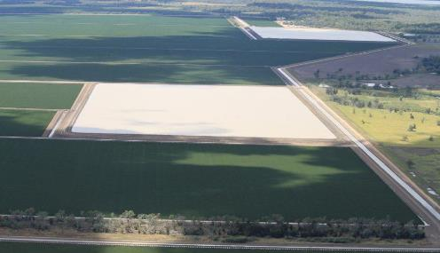
History of Irrigation
Irrigation has been around for a long time
20% of the world’s agricultural land is
irrigated producing 40% of the world’s food/fibre
Surface irrigation is used for 44% of the
irrigated land in Australia
Notes:
Irrigation has been around for as long as humans have been cultivating plants. Around 20 percent or 280 million hectares of the world’s cultivated farmland is irrigated, and this produces 40 percent of our food and fibre. Historically surface irrigation has been the most common method of irrigating agricultural land. It remains one of the most widely used form of irrigation for growing broad acre crops. It is the most common form of irrigation in Australia with 44 percent of the irrigated area using this method of irrigation.

Slide 18
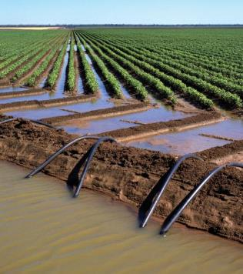
History of Irrigation
Siphon irrigation is the most common form of irrigation in Australia
It refers to the inverted U shaped tube which enables water to flow uphill, above the surface of the head ditch water, without pumps, powered by the fall of the liquid as it flows down the tube under the pull of gravity, and is discharged at a level lower than the surface of the head ditch.
furrow
bay
siphon
head ditch
Notes:
The primary method of surface irrigating within the Australian Cotton industry is the use of siphons to apply water from a head ditch into furrows in a cotton field. The term siphon (or siphon) comes from the Ancient Greek for “pipe” or “tube”. It refers to the inverted U shaped tube which enables water to flow uphill, above the surface of the headditch water, without pumps, powered by the fall of the liquid as it flows down the tube under the pull of gravity, and is discharged at a level lower than the surface of the head ditch. Egyptian reliefs from 1500 BC show the use of siphons to extract liquids from large storage jars.

Slide 19
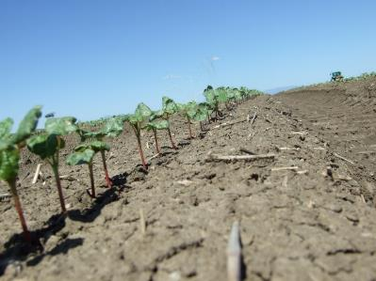
Why Irrigate?
To avoid cotton plant moisture stress
To increase yield and fibre quality
Need to irrigate carefully to avoid
wastage and ‘waterlogging’
Notes:
Without irrigation, growers are at the complete mercy of the weather. Plants can become “stressed” if there hasn’t been enough rain, In fact, there is a term used in cotton growing called ‘moisture stress”. This is where the plants are not receiving enough water. This can lead to low yields and poor fibre quality.
Not only can the plants suffer from not having enough water, they can also be given too much water. This can lead to ‘waterlogging’ which lowers crop yields, or the waste of water which lowers production per megalitre of water applied (the water use efficiency of the crop). Adding water through irrigation therefore requires careful management.

Slide 20
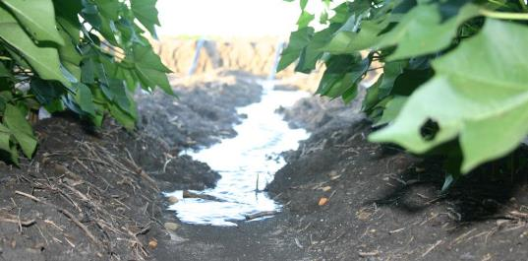
The aim of irrigation
To supply water to crops only when required
To apply water uniformly across the field so that each plant gets the amount required – neither too much nor too little
Notes:
The aim of irrigation is to supply water to crops when the water requirements are not satisfied by rainfall or available stored soil moisture. Water for irrigation comes from rivers or groundwater aquifers (which is pumped up to the surface via bores). Water is usually moved from a water storage via gravity through channels to head ditches and the field. This minimises the need for mechanical pumps and the cost of energy associated with pumping.
The aim is to apply water from the head ditch uniformly across the field, so that each plant has the amount of water it needs, neither too much nor too little. The most common form of surface irrigation in the cotton industry is furrow irrigation. Hills or beds are constructed on a downfield slope from the head ditch end to the tailwater end of a field. These are separated by furrows into which water is applied using siphons. The aim is to keep the water applied to a furrow within that furrow – water infiltrates into the crop root zone through the furrow base and walls. The crop is planted on the on the hills or beds.

Slide 21
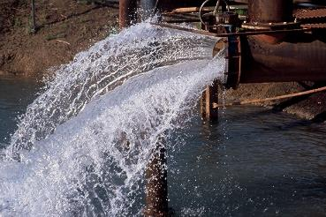
Parts of an irrigation system
storage dams
rivers
bores (access to underground water)

Slide 22
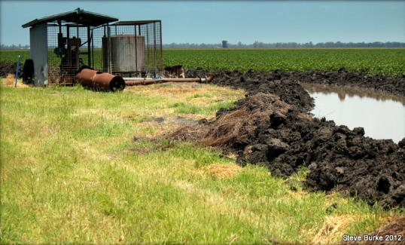
Parts of an irrigation system
Water delivery methods:
pipes
channels
furrows
culverts
pumps

Slide 23
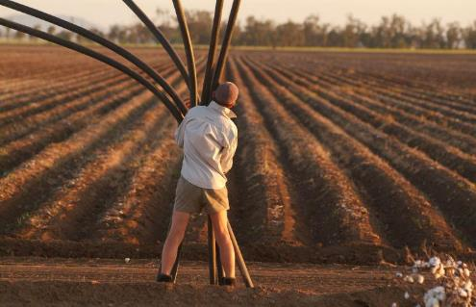
Parts of an irrigation system
Water delivery methods
siphons
lay-flat and cups
gated pipe
Photo by Georgie Carrigan

Slide 24
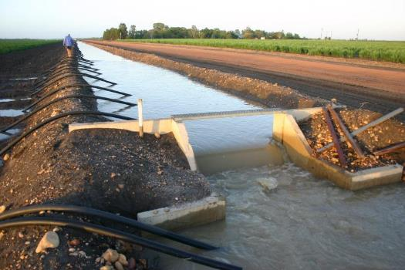
Parts of an irrigation system
Water control systems
gates
drop structures
checks
weirs
computerised
systems
Notes:
Water control systems: gates to control flow direction, drop structures to bring water into a channel, checks and weirs to stop water flow and increase head, computerised systems.

Slide 25
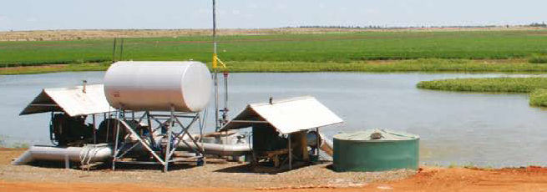
Parts of an irrigation system
Recycling system
tailwater channel
sumps
pumps
Notes:
Neek Morawitz of ‘Argoon’ Emerald, 2005 has constructed a central sump (pictured, also showing taildrain) as the gathering point for all tailwater on his farm. A 2000ML storage is adjacent to the sump and holds
all sediment-free tailwater, rainfall runoff and flood harvest from the river (Seek permission for photo from Scott Fanshawe, Emerald)

Slide 26
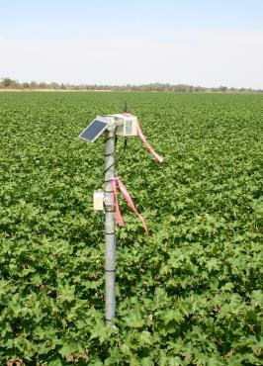
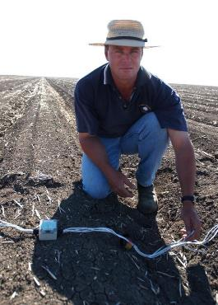
Parts of an irrigation system
Devices to measure the effectiveness of the irrigation system
Moisture probes
Pressure gauges
Notes:
Devices to measure the effectiveness of the irrigation system: soil moisture probes, pressure gauges

Slide 27
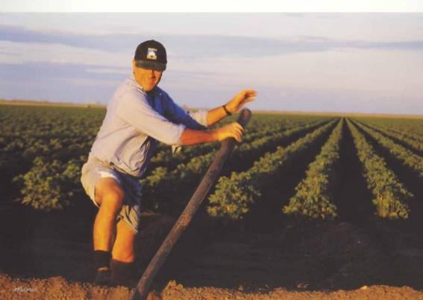
Starting a siphon: demonstration + practical
Notes:
The steps to starting a siphon are:
Place the head ditch end of the siphon beneath the water surface in the head ditch
Push the siphon into the water (leave the field end of the siphon open)
Close off the field end of the siphon with your free hand and pull this end away from the head ditch and towards the field (always leave the head ditch end submerged)
Repeat Step 3 until the siphon is filled with water (usually only 1 or 2 thrusts are needed depending on the amount of head available)
Once air is expelled you remove the seal formed by your hand so water will flow from the field end of the siphon and place it in the rotobuck (making sure the head ditch end remains submerged). Ideally the field end should be placed below the rotobuck water level (see Figure 2)

Slide 28
Timing of irrigation
Sometimes before planting
If moisture is lacking directly after planting
Total number of times depends on the season and soil type
The average number may be a further 6 irrigations, at 10 day intervals from mid December to late February or early March.
January-February is when the crop most needs water
Notes:
Timing of irrigation
Ideally the cotton crop should be planted into a seedbed which has adequate soil moisture. If there has been inadequate rainfall an irrigation may be applied prior to planting to ensure there is adequate rootzone moisture – this is referred to as a pre-irrigation.
In situations where soil moisture may be marginal following planting it may be necessary to apply an irrigation after planting to assist with establishment of the crop – this is called ‘watering up’ the crop. The number of in-season irrigations used after the crop has established varies with location, the frequency of rainfall and soil type – on average there may be a further four to five irrigations, at ten day intervals, from mid- December to late February or early March.
The time the crop really needs water the most is during January and February. This is when the temperatures and evaporative demand is highest, and the fruit on the plant (referred to as bolls) is starting to mature and fill. The timing of irrigation is crucial to achieve high yields (quantity) and high quality cotton fibres.

Slide 29
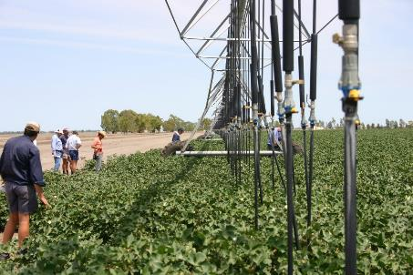
Efficient Irrigation
Goal is best use of water for best yield
No wastage
Design of irrigation systems is important
Water travel to rootzone
Run-off collected and recycled
Notes:
Efficient Irrigation
The goal of efficient irrigation is to ensure the greatest return per megalitre of available water is achieved. This requires the minimisation of losses through evaporation, deep drainage and runoff. Efficient irrigation requires good system design and irrigation management practices.
Careful design of irrigation systems (including the slope of field) is important to ensure:
Water travels down a field at just the right speed ensure an even infiltration into the rootzone;
That all run-off water is collected and recycled for re-use in the next irrigation.
Care taken in the application of water via siphons is also critical to achieving an efficient irrigation.

Slide 30
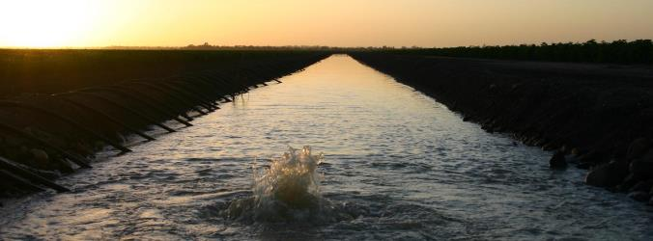
Part 3: Hydrology

Slide 31
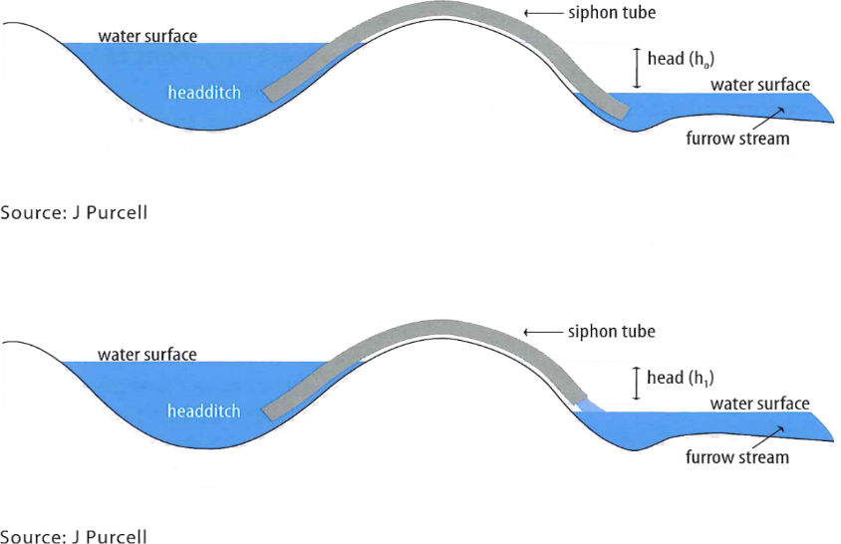
Hydraulics
Notes:
siphon tubes are basic implements used in irrigation to transfer water over a barrier (such as the bank of a raised irrigation channel. A siphon is a tube which uses air pressure and gravity to run water up over a high place and down to where you want it.
At the simplest they consist of a pipe with no working parts. To work they rely on the water level in the head ditch being at a higher level than the water level in the field being irrigated.
The water level in the head ditch is higher than the soil level in the bay or furrow so it will easily siphon using tubes. Normally one siphon is used for each furrow. The siphon is started by hand at the start of irrigation.
The purpose of a head ditch is to consistently deliver sufficient water at an appropriate head to the field. Management of the head ditch involves regulating flows in the system and selecting and operating siphons appropriately. Head ditch flow is regulated at the source, while head ditch levels are determined by downstream control structures. Water level should be kept constant as possible while irrigating, as fluctuations cause the siphon discharge to change leading to non-uniform application. To maintain a constant head requires the total siphon discharge in a siphon “set” (i.e. those siphons set to run at one time) equal head ditch inflow.
The aim is to achieve a steady flow rate onto the field through the use of siphon tubes transferring water over a head ditch bank onto the field. Figure 2 is a cross section of a siphon applying water from a head ditch for both submerged and free flow.
Normally one siphon is used for each furrow, although other combinations may be used on different fields – for example, doubling up siphons to increase flow rate in a furrow or applying water through siphons in every second furrow. Each siphon in an irrigation set is started by hand at the start of irrigation.
Figure 2 shows that the head for a siphon operating with submerged flow is greater than the head of a siphon operating with free flow (h_{o} is greater than h₁).

Slide 32
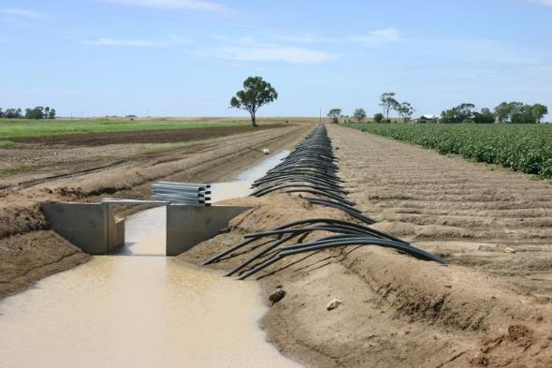
Practical 2: starting, monitoring and stopping an irrigation set

Slide 33
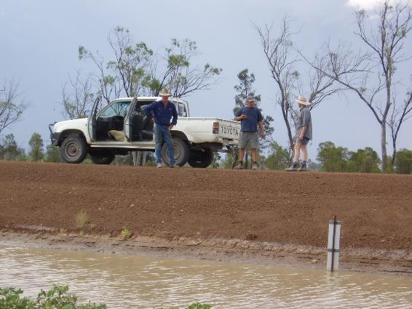
Part 4: Communication

Slide 34
Communication
What do you do if you are unsure what to do?
What do you do if you have been told and still don’t understand?
  A. Ask your supervisor
  B. Paraphrase (restate or restate as a questions)
  Demonstrate - Is this what you mean?
Notes:
A. Ask your supervisor
B. Paraphrase (restate or restate as a questions)
Demonstrate - Is this what you mean?

Slide 35
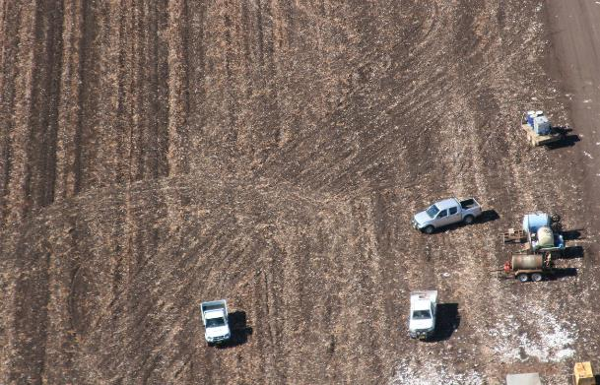
Part 4: Getting around

Slide 36
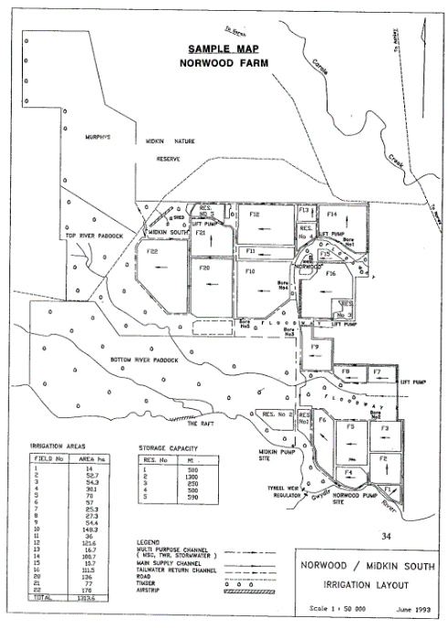
Map reading
Chances are you will be given a farm map
Find the main landmarks
Understand the legend
Each field will be numbered
Each pump, bore, supply channel, tailwater return channel, road and watercourse will be numbered
Notes:
Chances are when you arrive on farm you will be given a map. You will need to use this to get around and follow instructions. (Either use a farm map or use the one provided in the course body)
When you get the map look for the main landmarks to orientate the map.
Look at the legend to understand the map markings.
Each field will be numbered as will each pump, bore, supply channel, tailwater return channel, road and watercourse.
Discuss the abbreviations on the map and what they mean (e.g. RES = reservoir, F=Field)
Looking at the map identify some of the fields in which the group has already worked.

Slide 37
Troubleshooting
An irrigation set is underway but the water
level in head ditch is rising
Risk:
Cause:
Action:
Solutions:
Notes:
Go through this scenario as a group
Risk: Overtopping of head ditch and head ditch break possible
Cause: Not sufficient siphons running (some could be blocked)
Increased flow coming from elsewhere in irrigation system
Action: Contact manager
Solutions: Check all siphons operating properly
Increase number of siphons operating

Slide 38
Troubleshooting
Group 1: An irrigation set is underway but the water level in head ditch is falling
Group 2: An irrigation set is underway but the water is not advancing down furrows evenly
Discuss
Risk:
Cause:
Action:
Solutions:

Slide 39
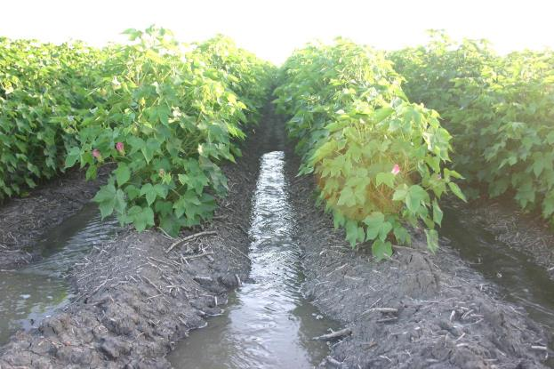
Practical 3:

Slide 40
Recap
What work health safety risks are there and what precautions would
you need to take?
What items to you need to take with you into the field?
What are the key components of an irrigation system
What hots tips could you give to a new staff member to work a siphon?
What can you do if you are not sure
of the instructions?

Slide 41
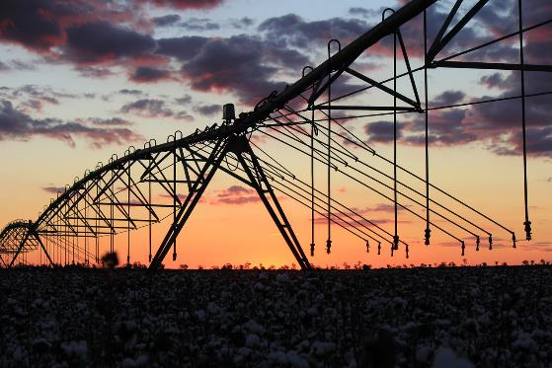
Any questions?
Evaluation

